Slide 1
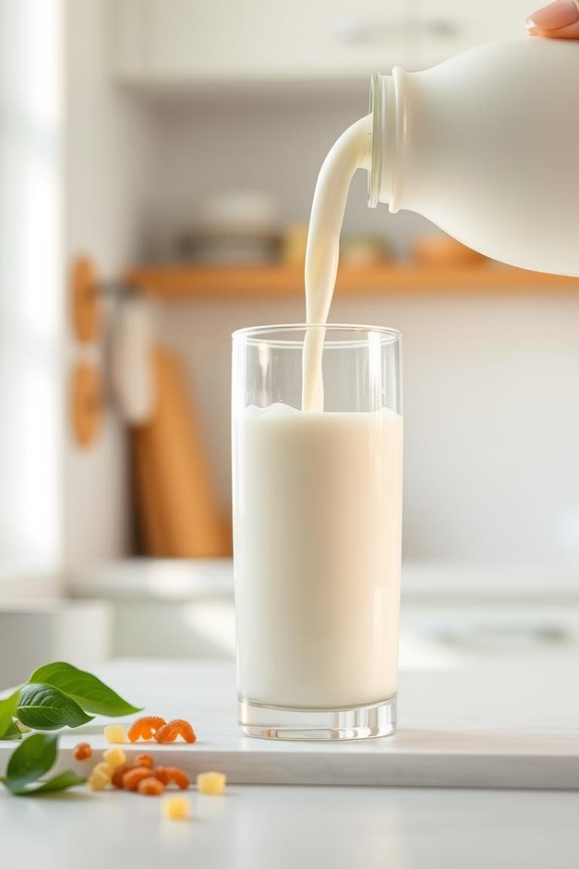

The Impact of Heat Processing on Milk's Nutritional Value
Exploring how heat treatments affect milk's vital nutrients. Understanding balancing safety and nutrition.
by vishal patel

Slide 2
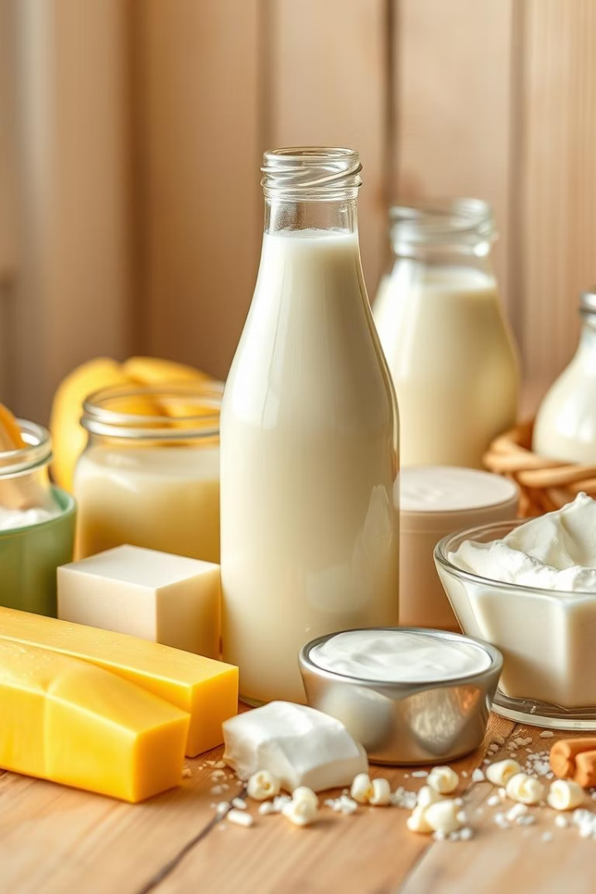
Introduction: Milk as a Nutritional Powerhouse
Rich in Nutrients
Dietary Importance
High-quality proteins, vitamins, minerals, and fats essential for health.
Supports bone growth, immune function, and energy metabolism for all ages.
Widely Consumed
Global staple providing key nutrients especially in children and elderly.

Slide 3
Common Milk Heat Treatments
Pasteurization
Ultra-High Temperature (UHT)
Heats milk to ~72°C for 15 seconds to kill harmful bacteria.
Heats milk above 135°C for 2-5 seconds for longer shelf life.

Slide 4
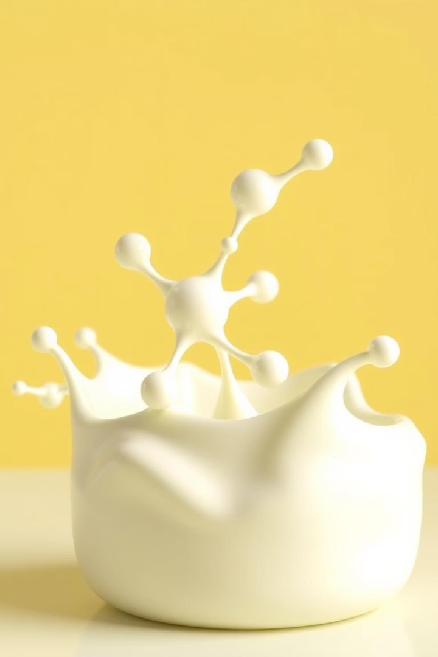


Effect of Heat on Milk Proteins
Whey Proteins
Casein Proteins
Highly sensitive; heat causes denaturation reducing bioavailability.
Heat stable; forms micelles protecting protein functionality.

Slide 5
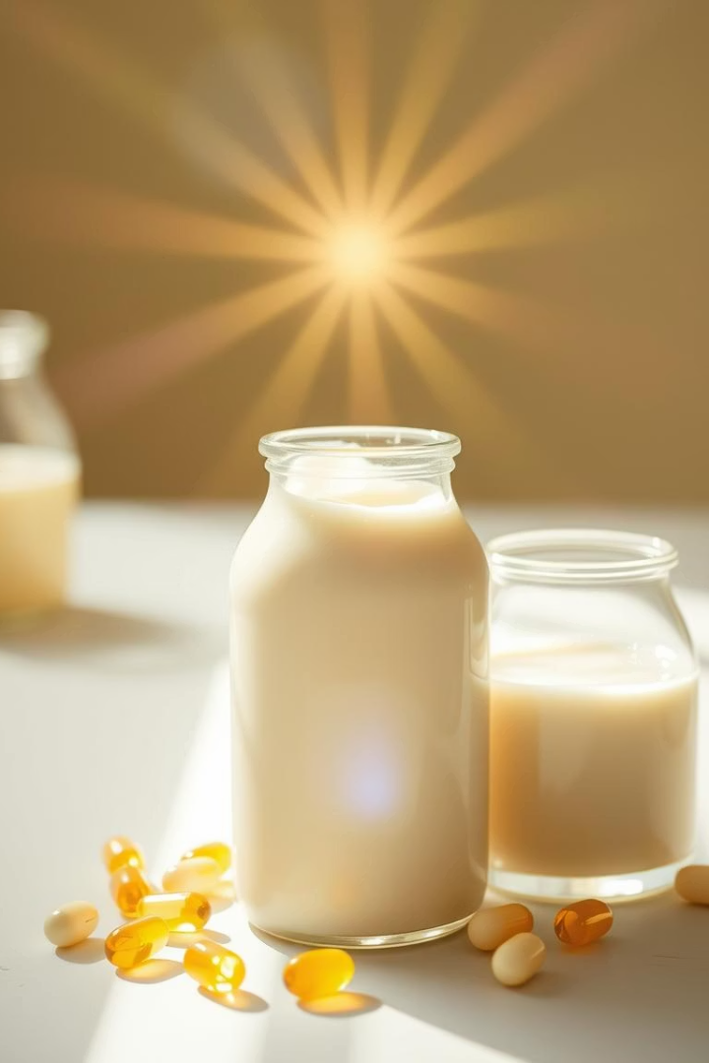
Impact on Milk Vitamins
Heat-sensitive Vitamins
Heat-stable Vitamins
Vitamin C and B complex degrade significantly during heating.
Vitamins A and D remain relatively stable under heat treatments.
Overall Nutrient Loss
Minimal with proper heat control; essential vitamins retained mostly.

Slide 6
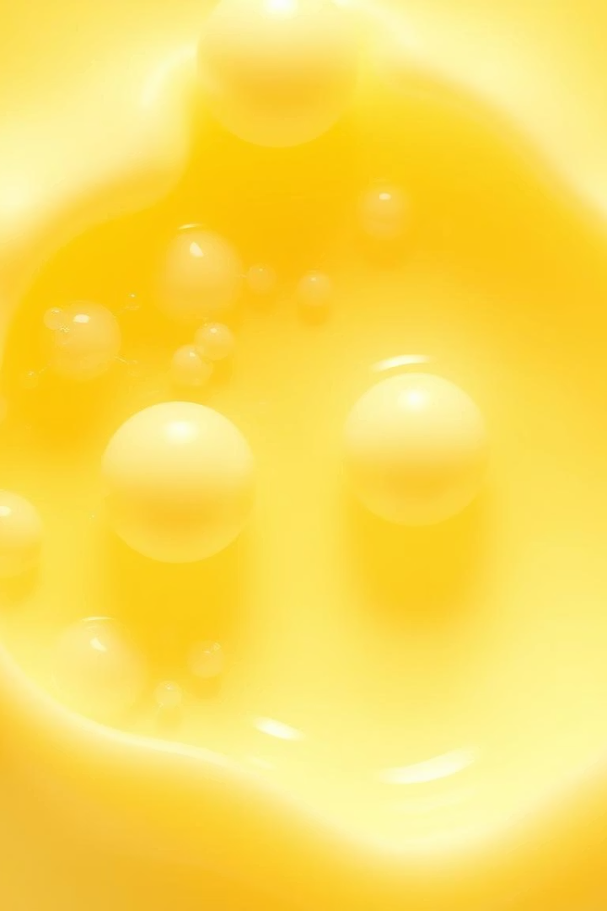
Changes to Milk Fats and Fatty Acids
1
Fat Stability
2
Free Fatty Acids
Fats generally remain stable but some short-chain fats may break down.
Heat can increase free fatty acids causing slight flavor changes.
3
Oxidation Risk
Prolonged or intense heating may lead to fat oxidation and off-flavors.

Slide 7



Effects on Lactose and Carbohydrates
Maillard Reaction
2
Heat can trigger reactions between sugars and proteins, impacting color and flavor.
Lactose Stability
1
Generally stable; minimal breakdown during standard heat processing.
Digestive Impact
3
Slight heat impact on lactose does not significantly affect digestion.

Slide 8

Are Minerals Affected by Heat Processing?
Mineral Stability
Bioavailability
Overall Mineral Retention
Most minerals like calcium and potassium remain stable during heating.
Small changes may occur but generally not impactful on absorption.
Heat processing preserves mineral content effectively.

Slide 9
Sensory Changes: Taste & Texture
Taste
Texture
Heat intensifies cooked flavor; slight sweetness from sugar reactions.
Heating affects creaminess and thickness due to protein changes.

Slide 10

Summary: Balancing Safety and Nutrition
Maintain Quality
Preserve Nutrients
Minimize sensory changes for consumer acceptance.
Ensure Safety
Optimize conditions to minimize nutrient loss.
Heat treatment kills pathogens effectively.

